Slide 1
[Part of this presentation is adopted from Prof. Leskovec, Stanford University, USA]
Support Vector Machine (SVM)
Md. Golam Rabiul Alam
Associate Professor, BRAC University

Slide 2
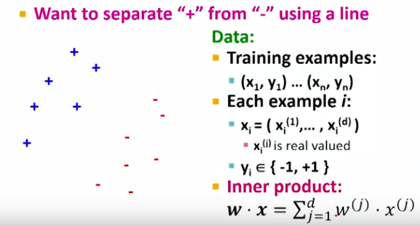
SVM

Slide 3
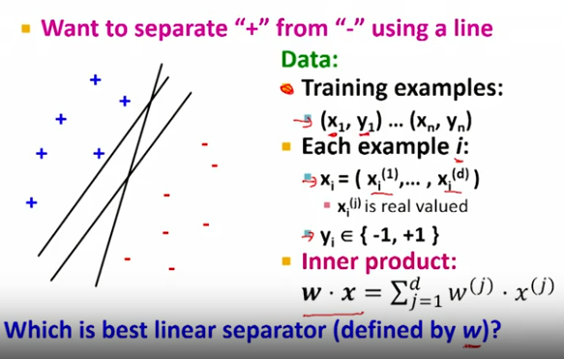
SVM

Slide 4
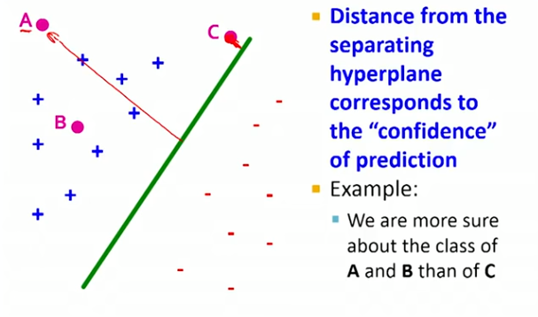
SVM

Slide 5
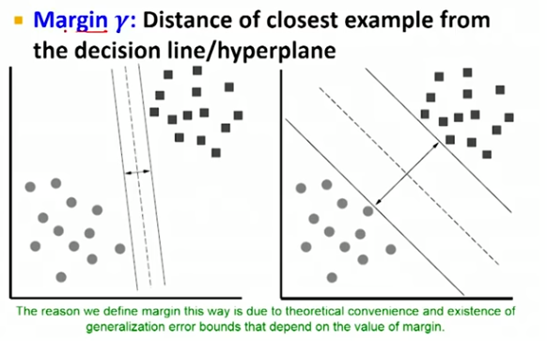
SVM

Slide 6
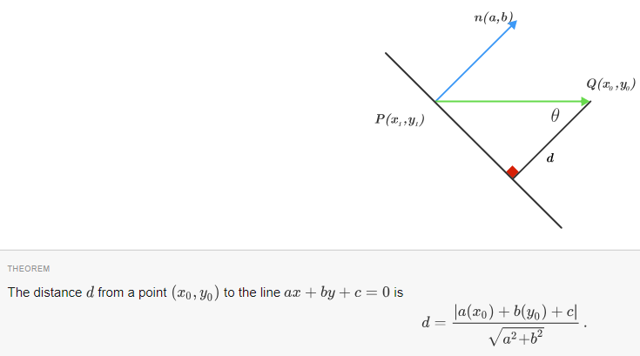
SVM

Slide 7
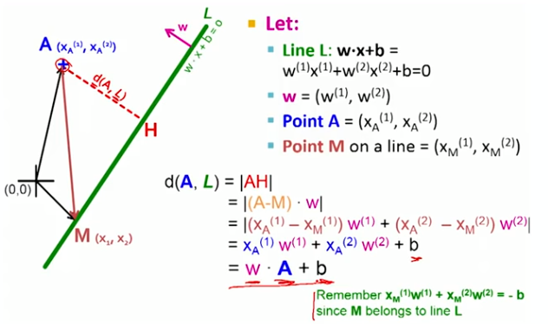

SVM

Slide 8
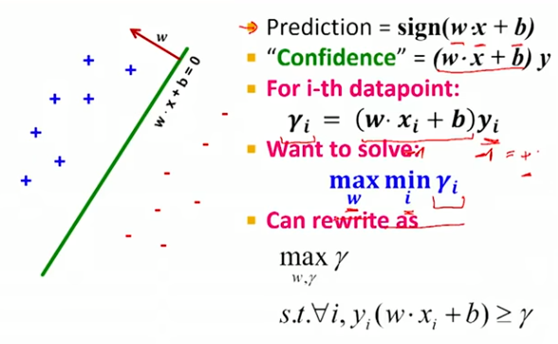
SVM

Slide 9
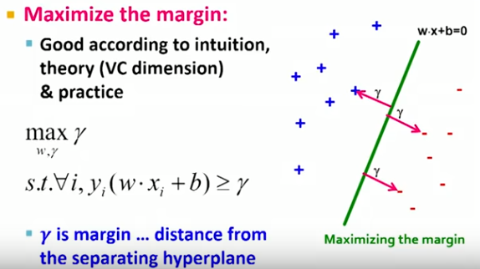
SVM

Slide 10
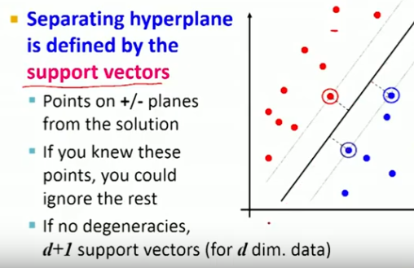
SVM

Slide 11
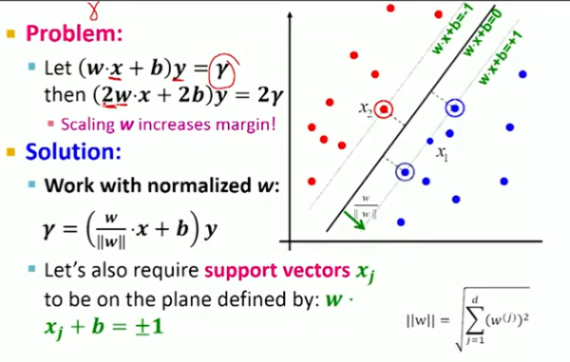
SVM

Slide 12
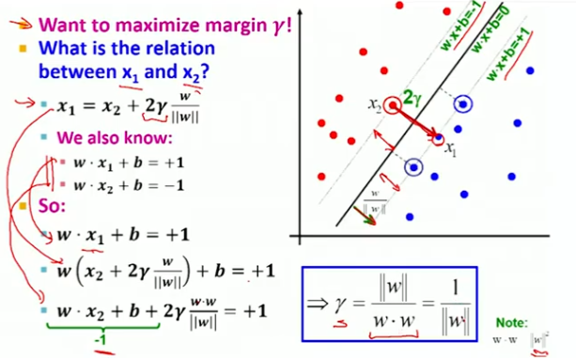
SVM

Slide 13
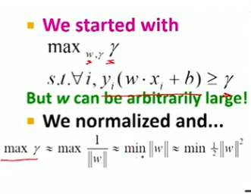
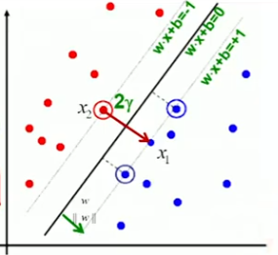
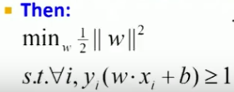
SVM
SVM with hard constraints

Slide 14
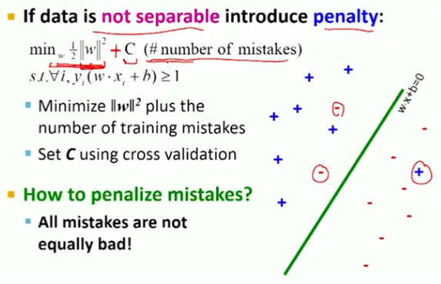
SVM (Not Linearly separable data)

Slide 15
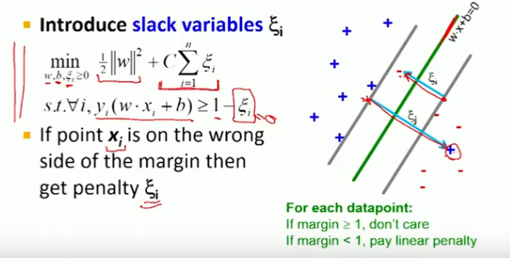
SVM

Slide 16
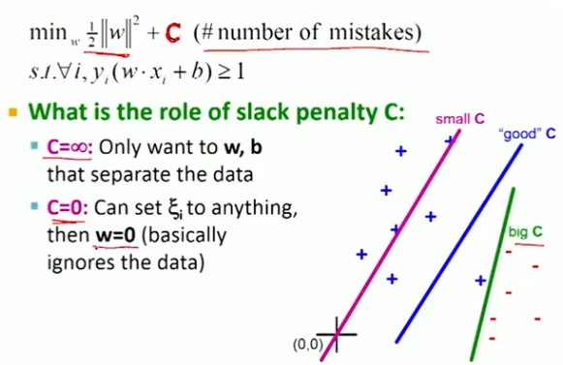
SVM

Slide 17
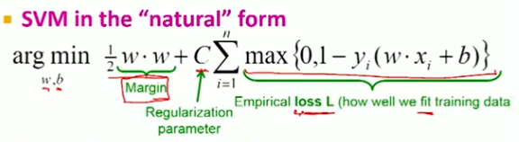

SVM in Natural Form
Hinge Loss

Slide 18
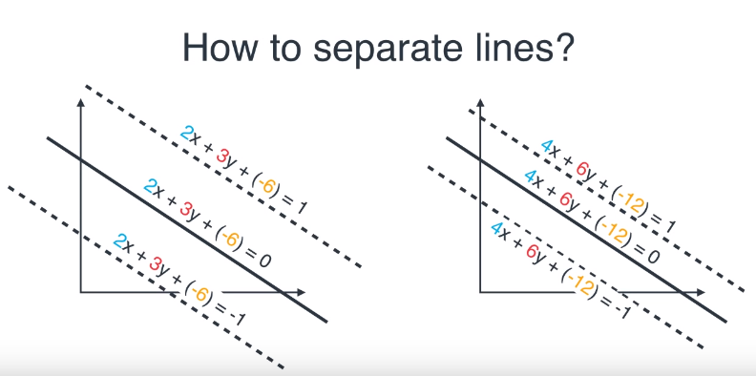
How to separate Lines

Slide 19
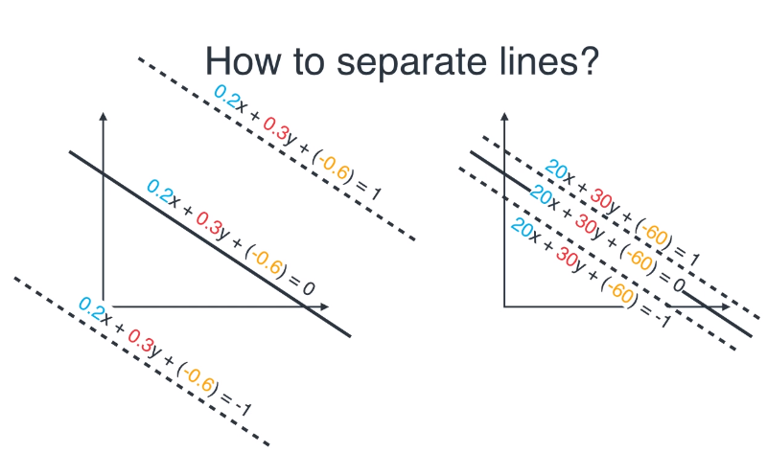
How to separate Lines

Slide 20
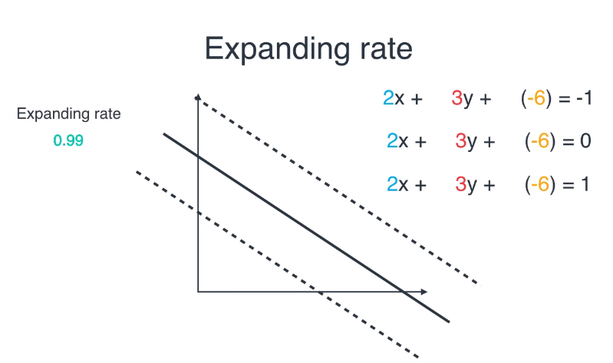
Expanding Rate

Slide 21
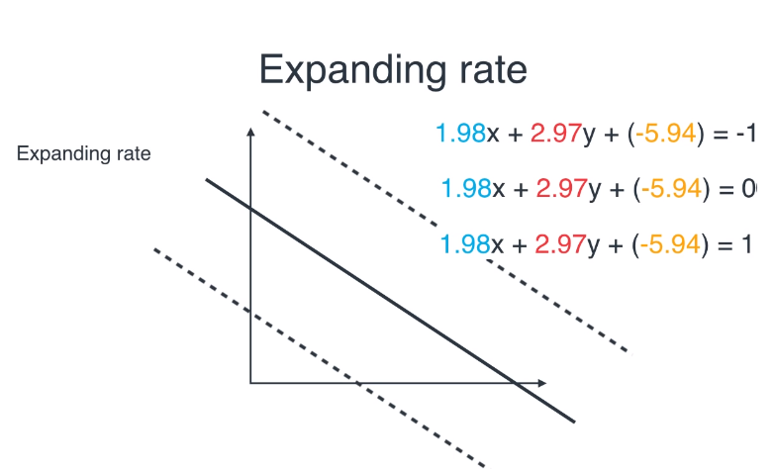
SVM

Slide 22
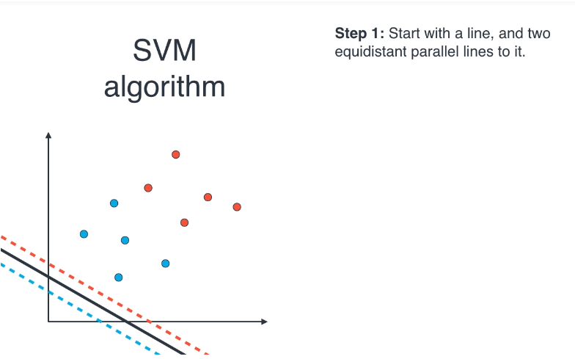
SVM algorithm

Slide 23
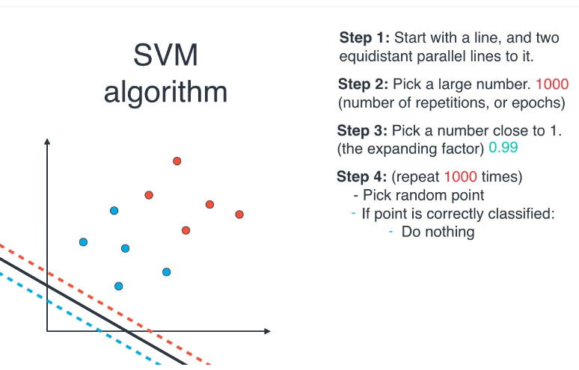
SVM Algorithm

Slide 24
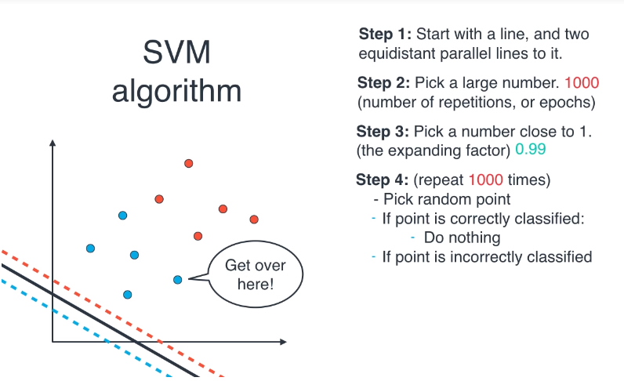
SVM algorithm

Slide 25
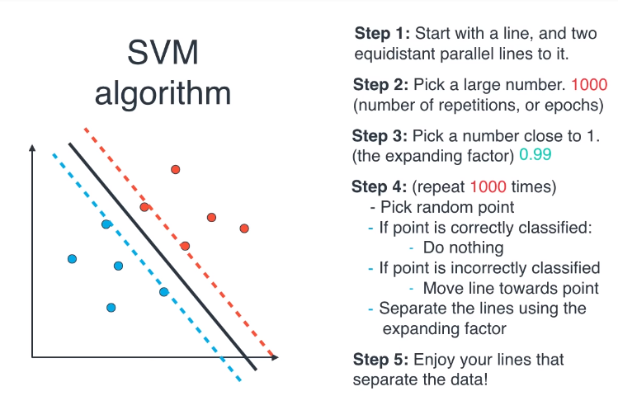
SVM Algorithm

Slide 26
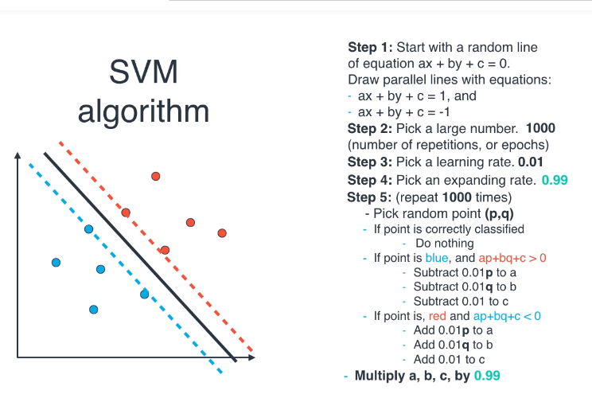
SVM algorithm

Slide 27
Line properties
Given the following: point P(x1,y1) line Ax+By+C=0 (in general form)
((Ax1+By1+C)/B)>0 if P is above the line.

Slide 28
References
https://brilliant.org/wiki/dot-product-distance-between-point-and-a-line/
https://youtu.be/ax8LxRZCORU
https://www.youtube.com/watch?time_continue=2&v=Lpr__X8zuE8

